Slide 1
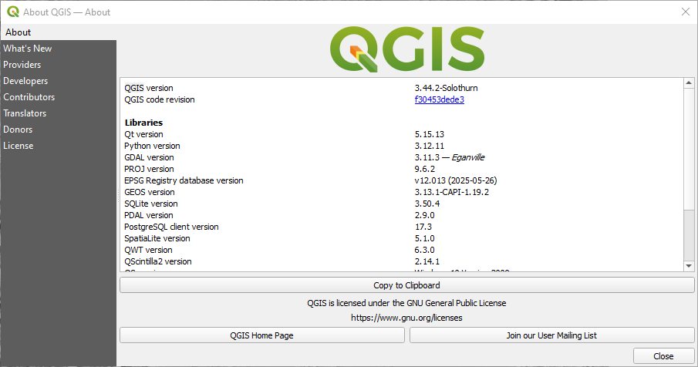
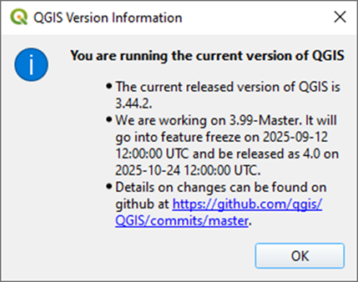
KURT Data August 29, 2025

Slide 2
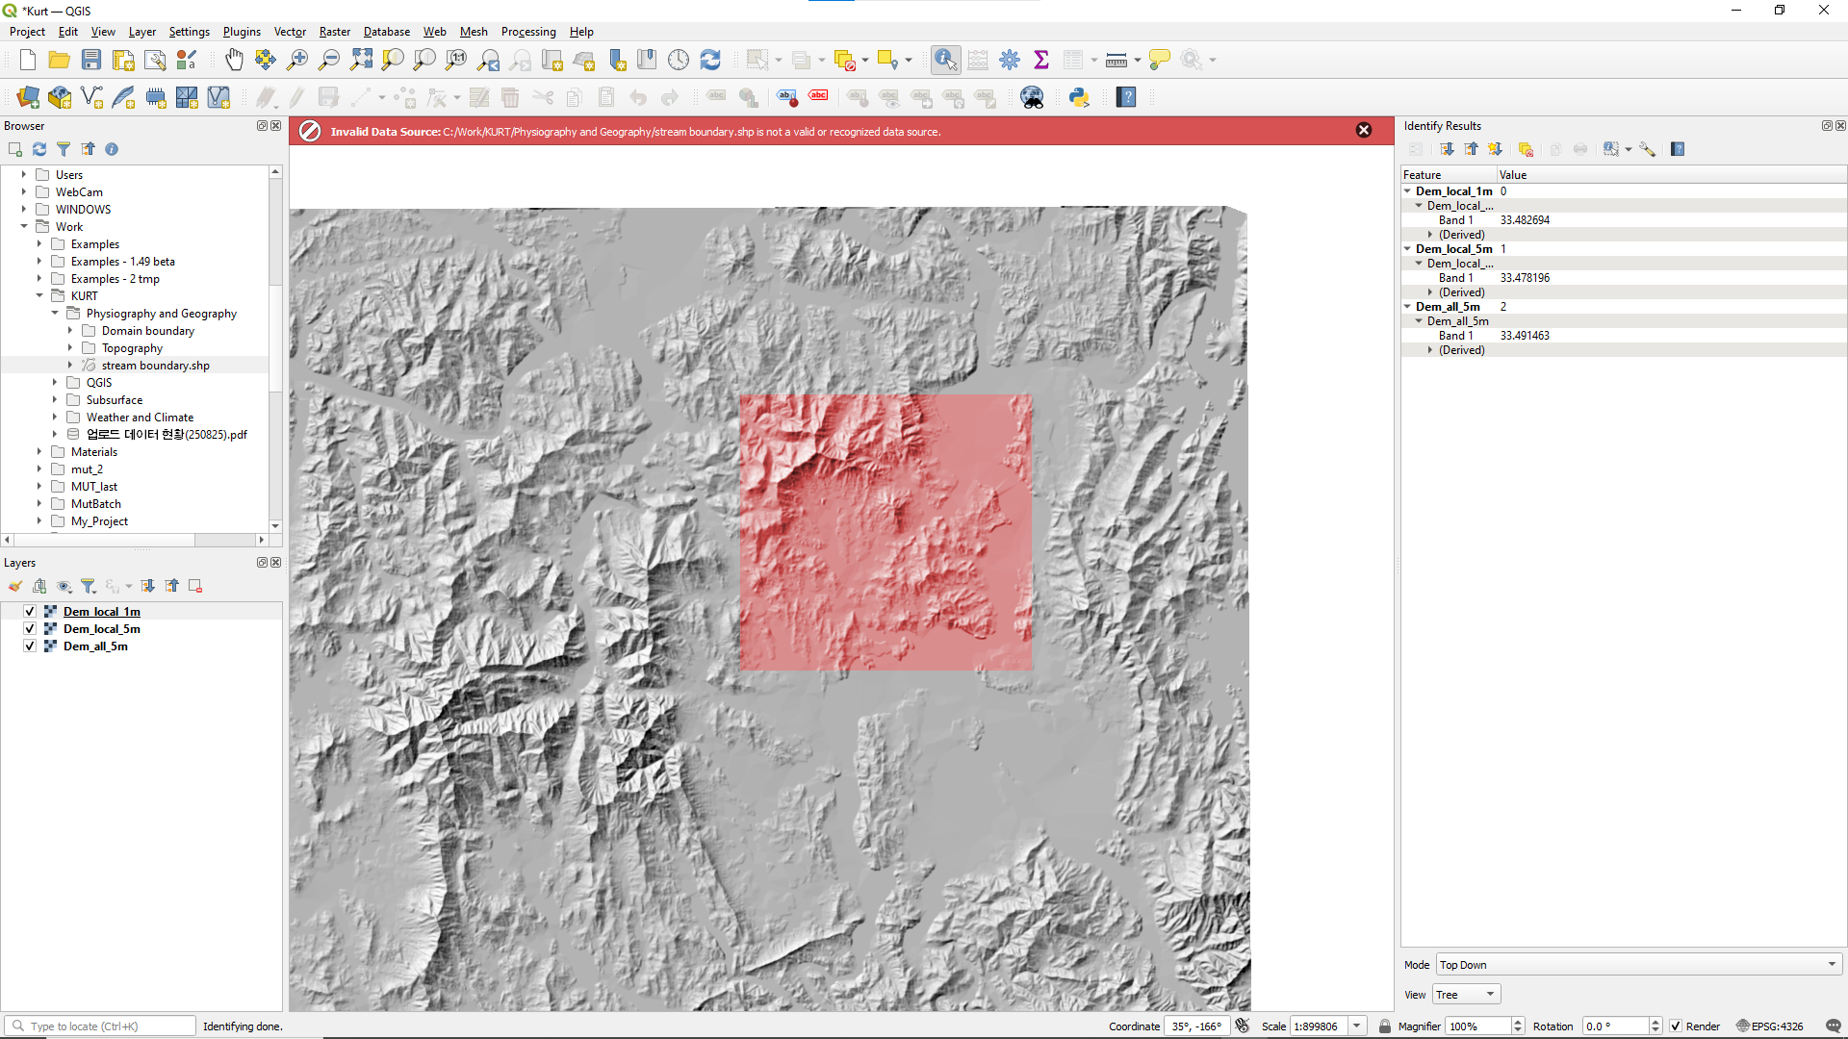
Tiff files with Elevation data
I was able to load all of the TIFF files with elevation data
I could not load any of the SHP files with domain boundaries or streams
I get an Invalid data source error when I try to load any of the SHP files

Slide 3
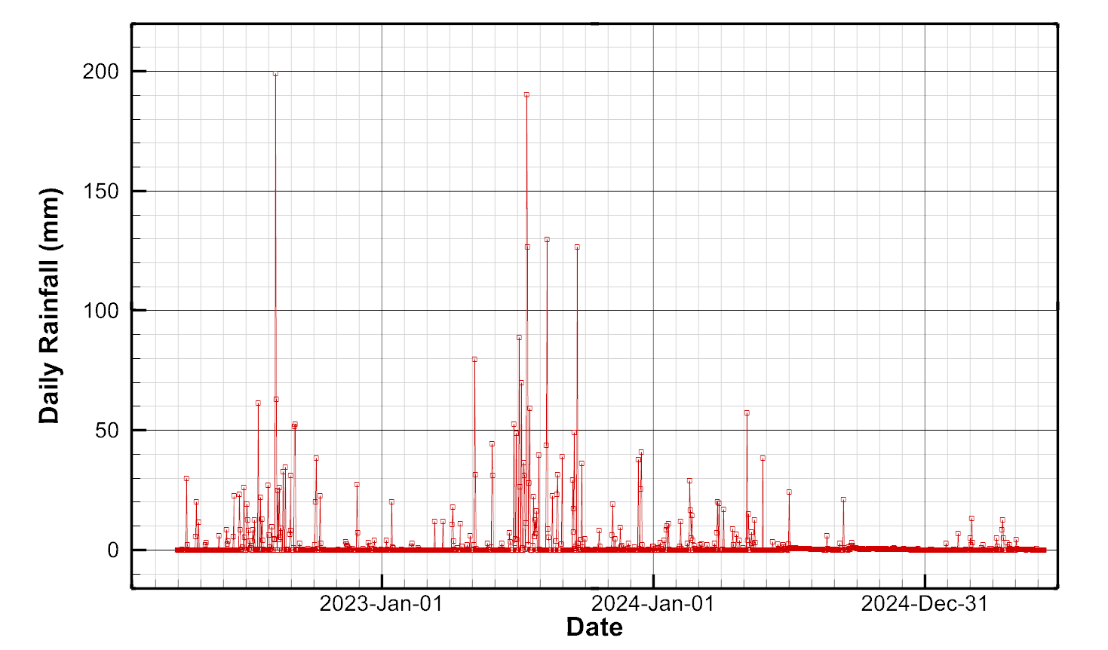
NOTES:
3 years of rainfall data
2024 was very dry

Slide 4
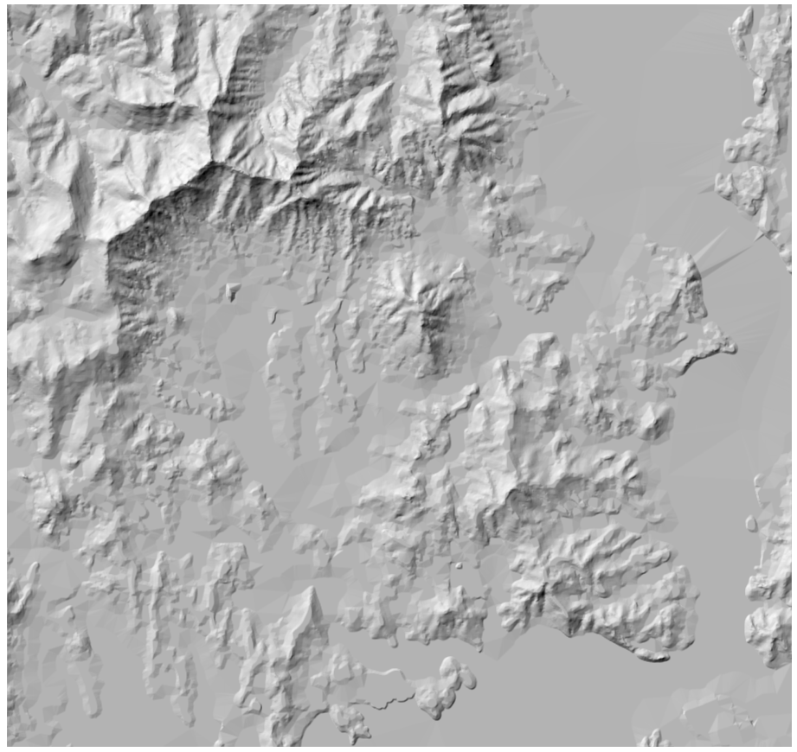
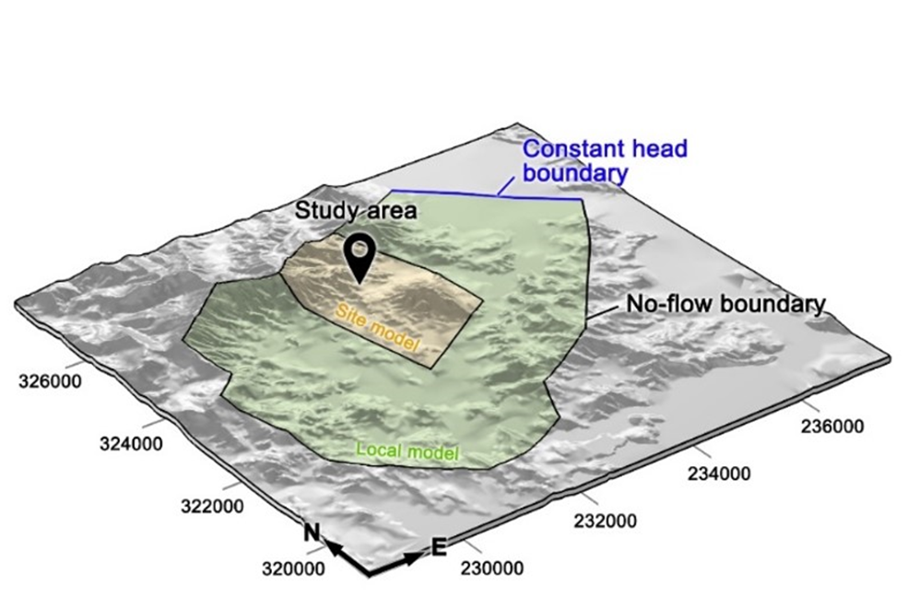
For testing, I’ll try to digitize an approximate
local boundary in QGIS as shown by the orange boundary here

Slide 5
What I’ve done so far:
digitize an approximate local boundary in QGIS
Export the coordinates around the boundary to a csv file
Import the coordinates to Grid Builder
Generate a coarse test mesh
Import the Grid Builder node coordinates (XY) back into QGIS
Sample the DEM Local 1m grid elevations at the Grid Builder node locations
Export them back into Grid Builder and create a node properties file called elevation
Copy the Abdul problem and modify it to:
have 3 layers with approximate K values and stratigraphy for the 3 KURT zones based on Borden sand properties (except K)
Use an average rainfall of 3.6341E-08 m/s calculated from KURT data
Assign a critical depth outlet along the straight boundary portion
The next 2 slides show the mesh and SWF domain with elevation contours
I’m going to try running it to steady-state next

Slide 6
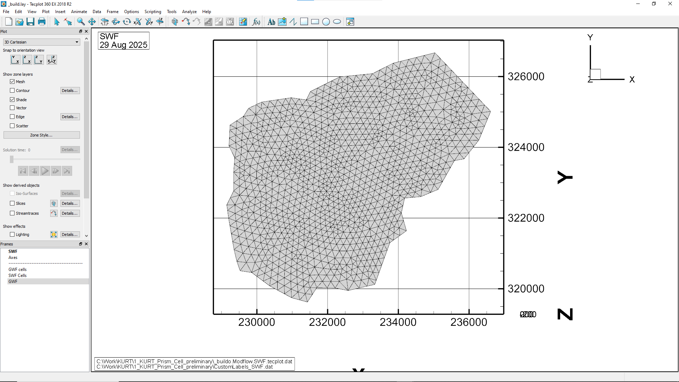

Slide 7
